Slide 1
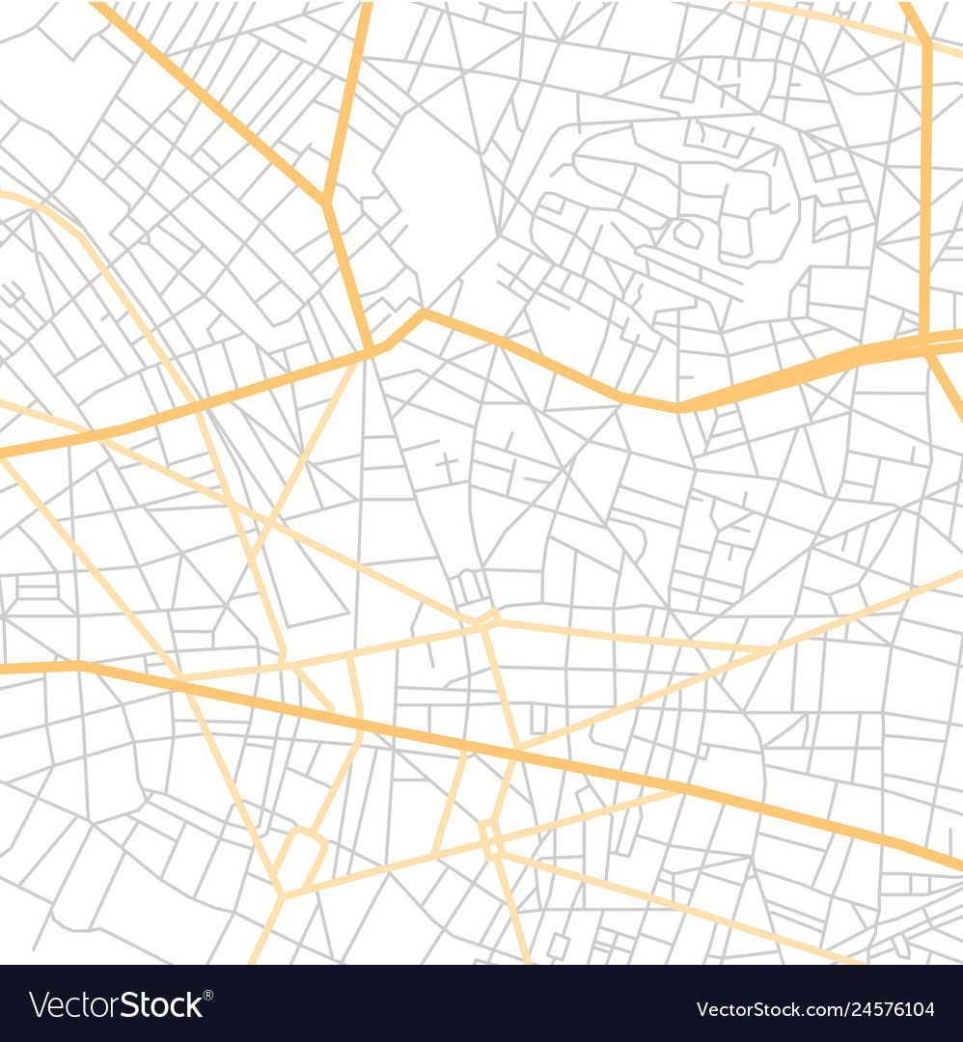
kkmk

Slide 2
